Slide 1
Capstone project - Eleckart
Mid submission
Team members
Senthilnathan Chandran
Vikram Patil
Vernon Fernandes
Nikhil Gupta

Slide 2
Business Understanding
ElecKart is an e-commerce firm specializing in electronic products. Over the last one year, they had spent a significant amount of money in marketing. Occasionally, they had also offered big-ticket promotions (similar to the Big Billion Day). They are about to create a marketing budget for the next year which includes spending on commercials, online campaigns, and pricing & promotion strategies. The CFO feels that the money spent over last 12 months on marketing was not sufficiently impactful, and, that they can either cut on the budget or reallocate it optimally across marketing levers to improve the revenue response.
Goals:
Develop a recommendation system for budget optimization.
Build a market mix model to observe the marketing impact
Recommend a optimal budget for categories: camera, gaming accessory & home audio

Slide 3
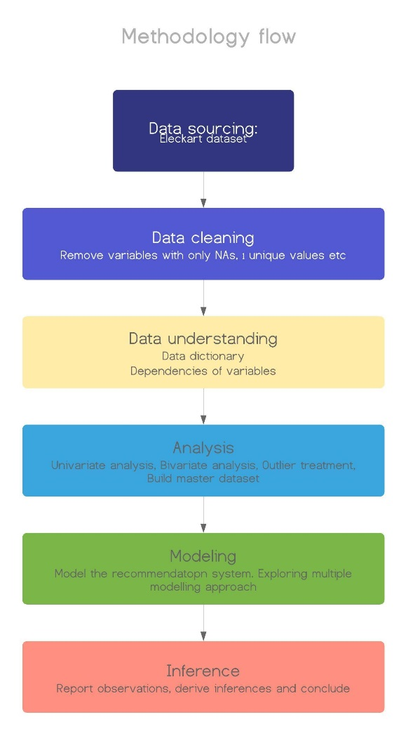
Methodology
Crisp DM framework:
Data sourcing
Data cleaning
Data understanding
Data Analysis
Data Modeling
Data inference

Slide 4
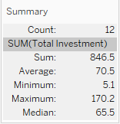
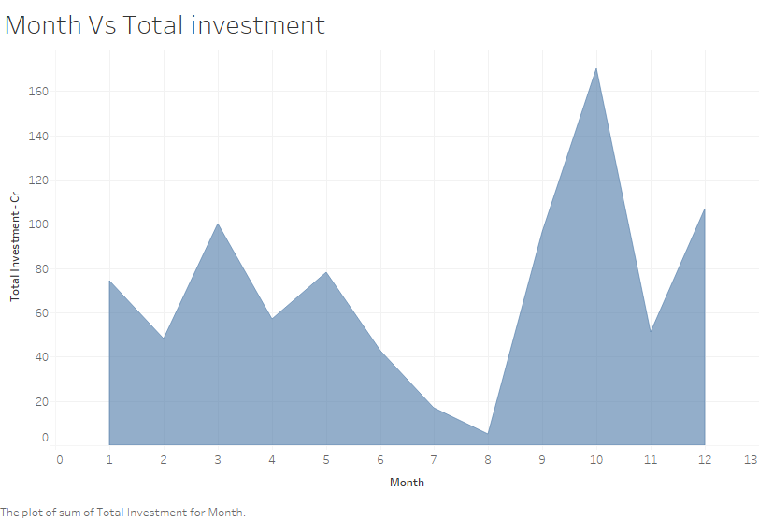
Data understanding and cleaning
Source | Data | Observations | Variables | Comment
Media data and other information | Media investment | 12 | 12 | Investment in different categories
 | Monthly NPS score | 1 | 12 | Monthly VoC
 | Special sale days | 12 | 4 | Special sale days/big promotion
Consumer Electronics | Monthly order | 1638021 | 12 | Daily product order data on different categories and sub-categories

Slide 5
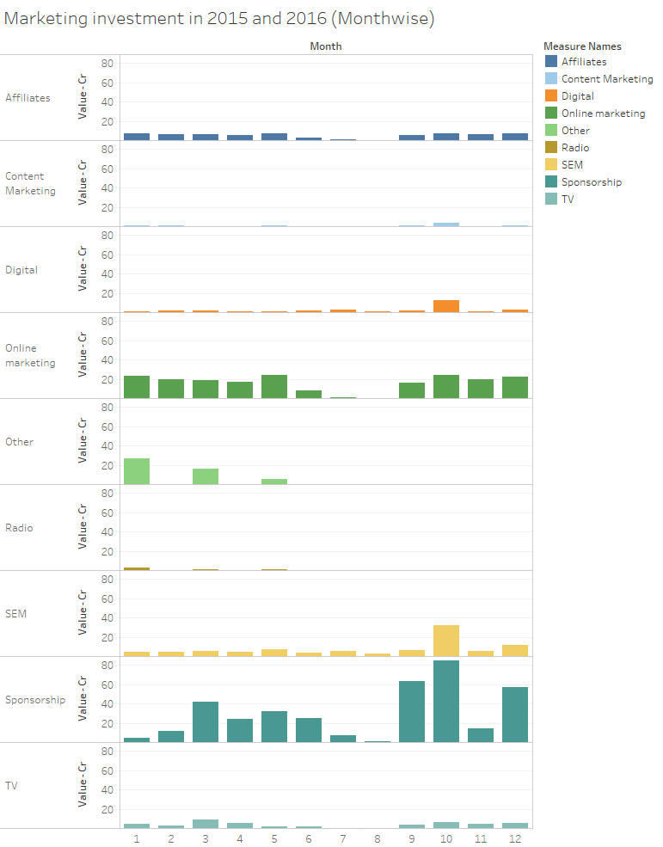
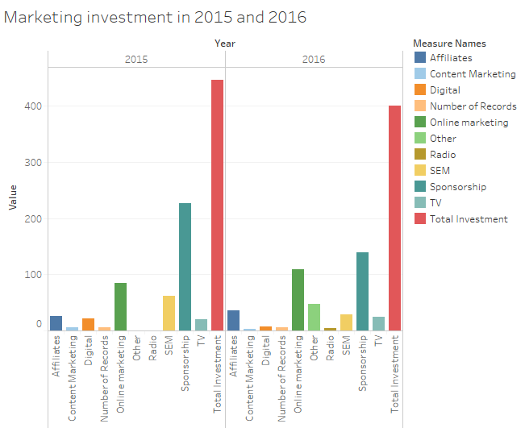
Exploratory Data Analysis

Slide 6
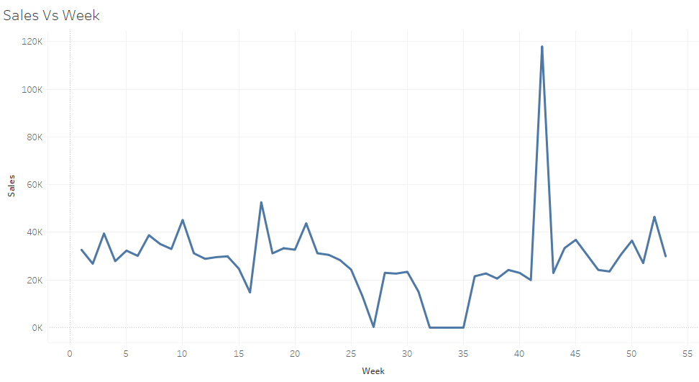
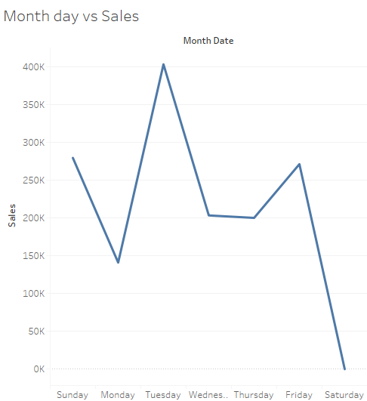
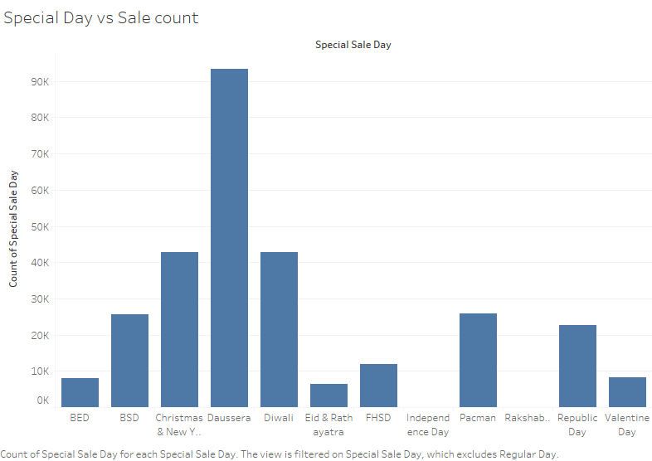

Slide 7
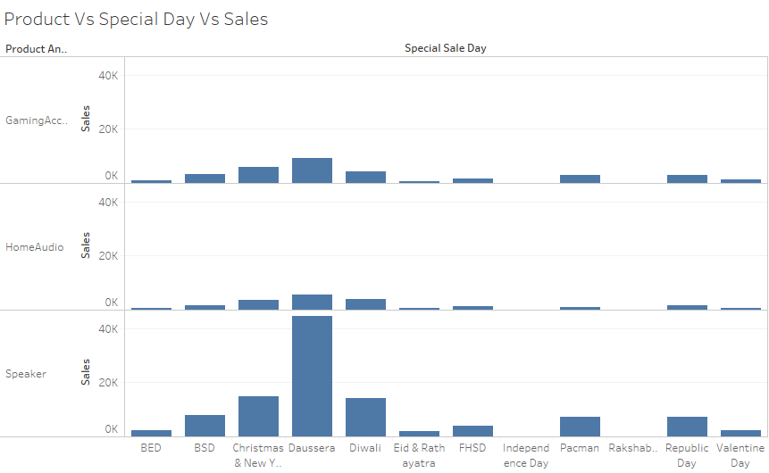
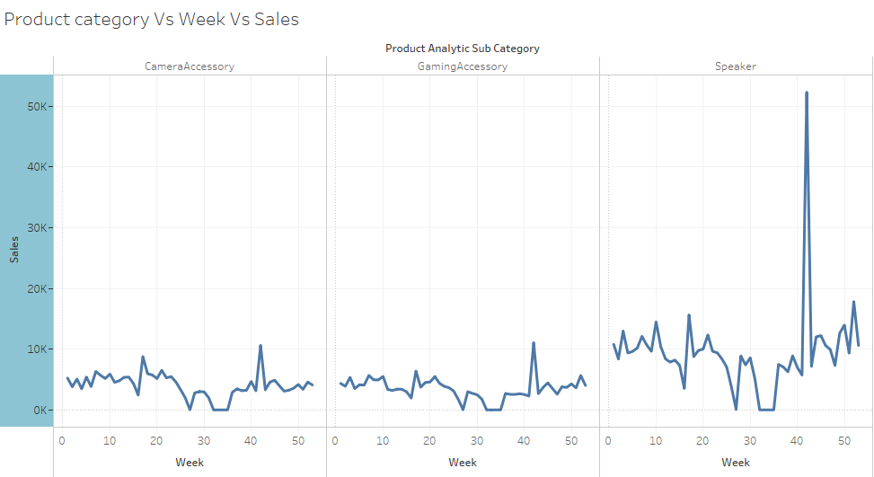

Slide 8
Observations
Spend Analysis
Ad spend is high in October - 2015 and lowest in Aug 2015
Above average spend during Sep, Oct, Dec, Jan, Mar and May
Lowest spend on content marketing. Highest spend on Sponsorship.
Analysis and Observations - Sales
When sales are high, Ad-spend is also high
Sales are low during weeks 6-9. Also, the ad spend.
Sales are highest on Tuesdays. Dussehra records most number of sales.

Slide 9
KPIs
week_no | Week number 1 starting from July 2015 to 53-June 2016
Month | Month from July 2015 to June 2016
Year | 2015, 2016
product_analytic_category | Camera, Gaming, etc
product_analytic_vertical | Vertical category
prepaid_count | Count of prepaid/week
cod_count | Count of COD/week
Total gmv | Total Units sold/week
Total units | Sum of product MRP
total_product_mrp | Sum of product MRP
Avg_gmv | Average gmv
Avg_mrp | Average mrp value
list_price | total_gmv/total_units
avg_price | Average list price
Media Type | TV, Digital, Sponsorship, Content, Marketing, Online Marketing, Affiliates, SEM, Radio, Others
NPS | Customer Voc
Is special day? | Derived KPI
Special day | Derived KPI

Slide 11
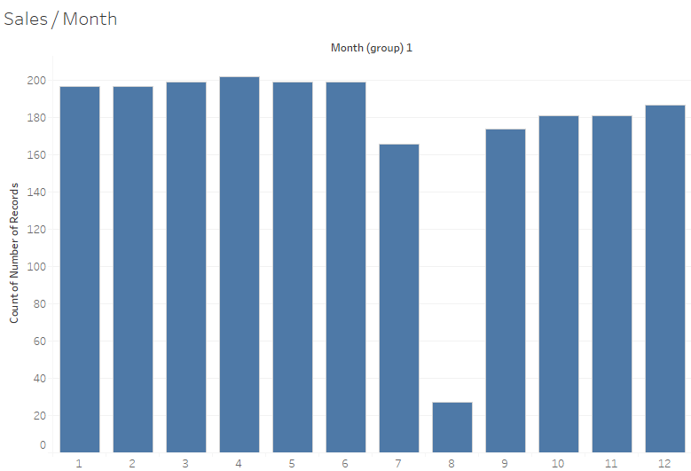
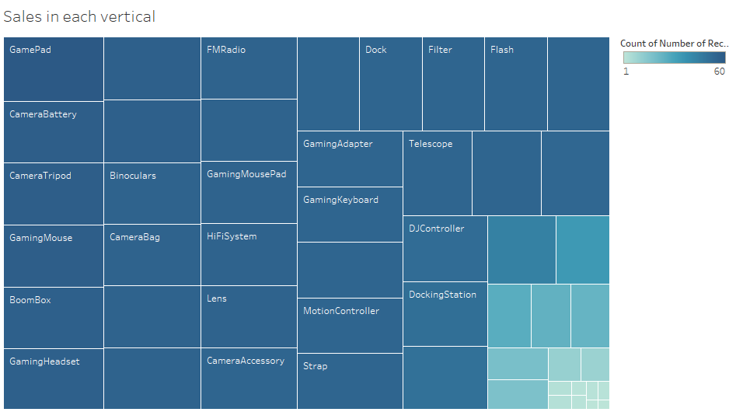
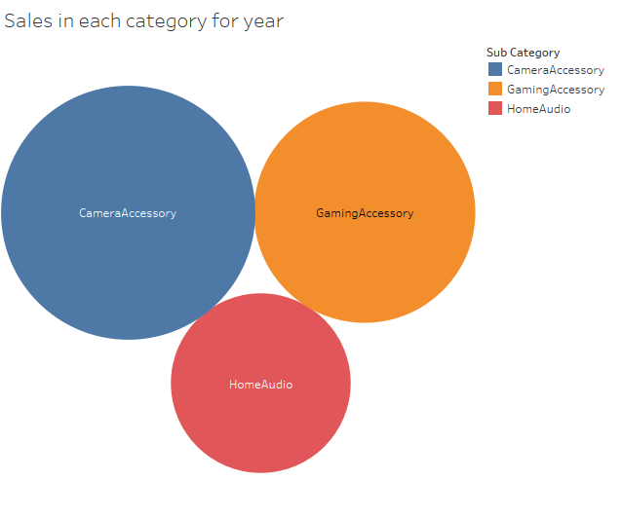
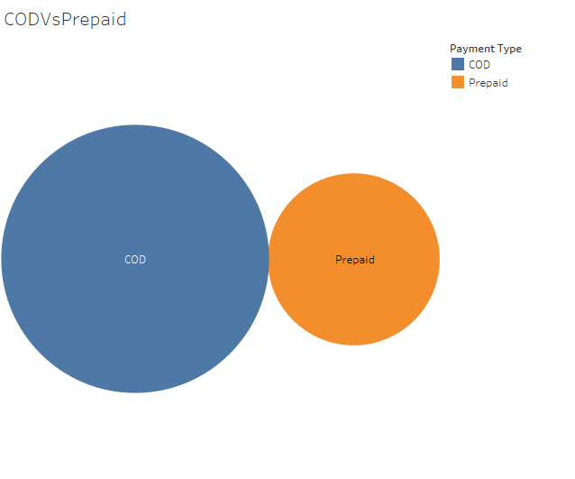
Univariate Analysis

Slide 12
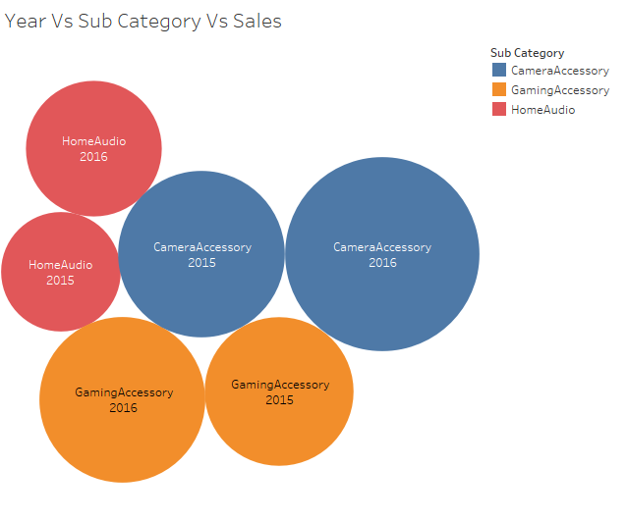
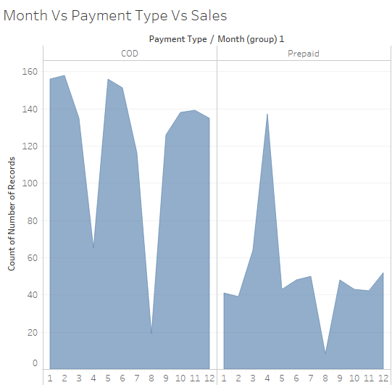
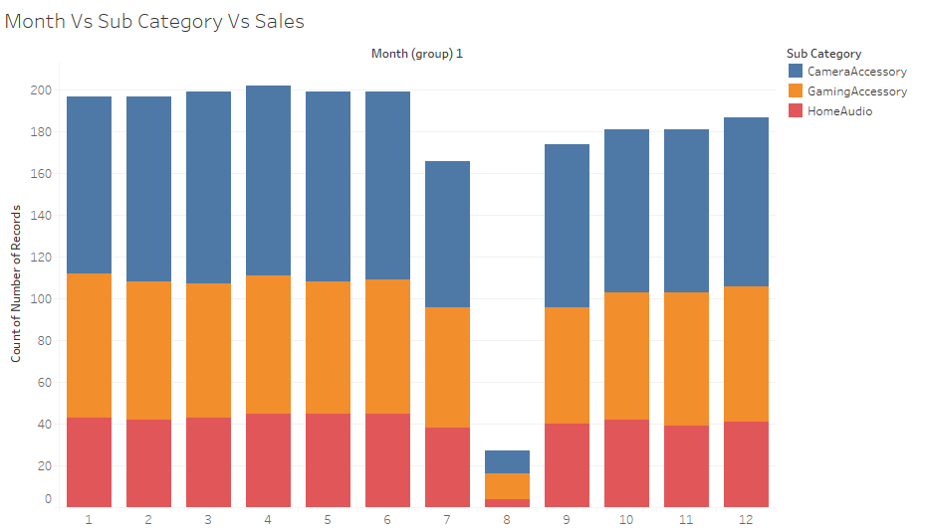
Bivariate Analysis

Slide 13
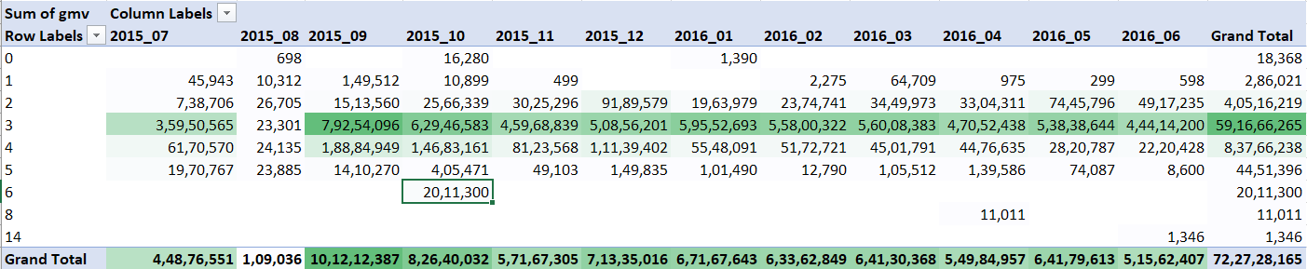
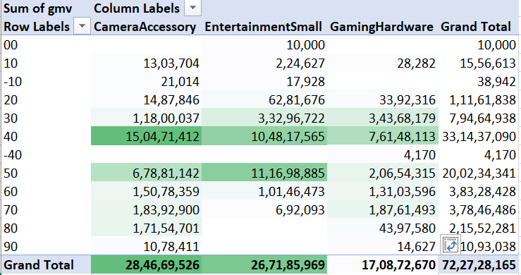
Month and Payment type
Month and procurement SLA:
Month and Discount:

Slide 14
Inferences
April has more prepaid orders than Cash on Delivery. For all other months it is the other way around.
June has few orders where procurement took 14 days.
April has few orders where procurement took 8 days.
October has few orders where procurement took 6 days.
Only January and October has few deliveries, which were charged more than MRP by 30 to 40%.
October has minimum promoter score.
July has maximum promoter score.
September:
More than half the Merchandize comes from 1,000 orders.
One third of Merchandize comes from 10,000 orders .
It means most of the revenue comes from high value orders.
October gets most of its revenue comes from low value orders.
Most weeks offer between 30 and 50% discount.
Week#42 has discount range of 40 to 60% for most of the GMV.

Slide 15
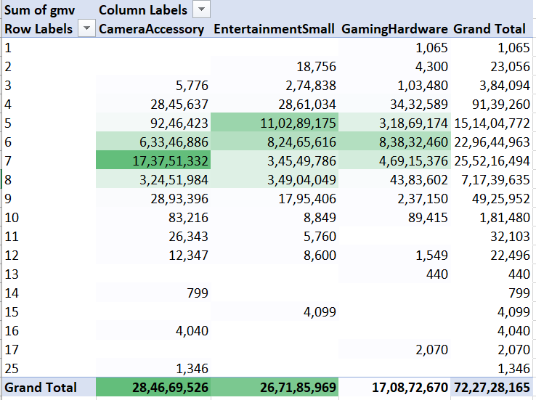
Home Audio speakers get from 30 to 50% discount whereas Lens mostly get 30 to 40% discount.
Most verticals get paid as Cash on delivery, whereas only Lens gets paid equally with prepaid orders.
Home Audio Speakers generate most revenue (18 Crores) with less than a thousand units.
Lens generate second most revenue (9 Lakhs with less than 100 units and 3 Lakhs with less than 1000 units).
Small entertainment has discount range of 30 to 50%.
Other two categories have slightly smaller discounts ranging from 30 to 40%.
Camera Accessories (mostly Lens) have highest delivery SLA of 7 days.
Gaming Hardware have average delivery SLA of 6 days.
Small entertainment (mostly Home Audio Speakers) get delivered in shorter SLA of 5 days.
Note: Procurement SLA for all 3 categories is same (3 days).
It means Camera accessories (mostly Lens) stays in inventory or transit for longer days (4 days) whereas Small entertainment (Home Audio Speakers) stay in inventory of transit for 2 days.

Slide 16
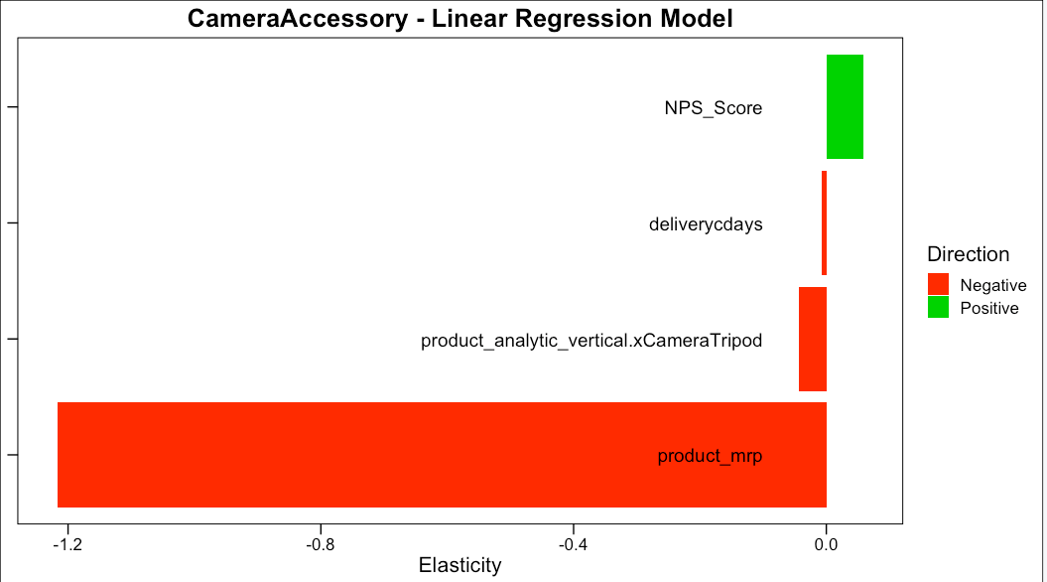
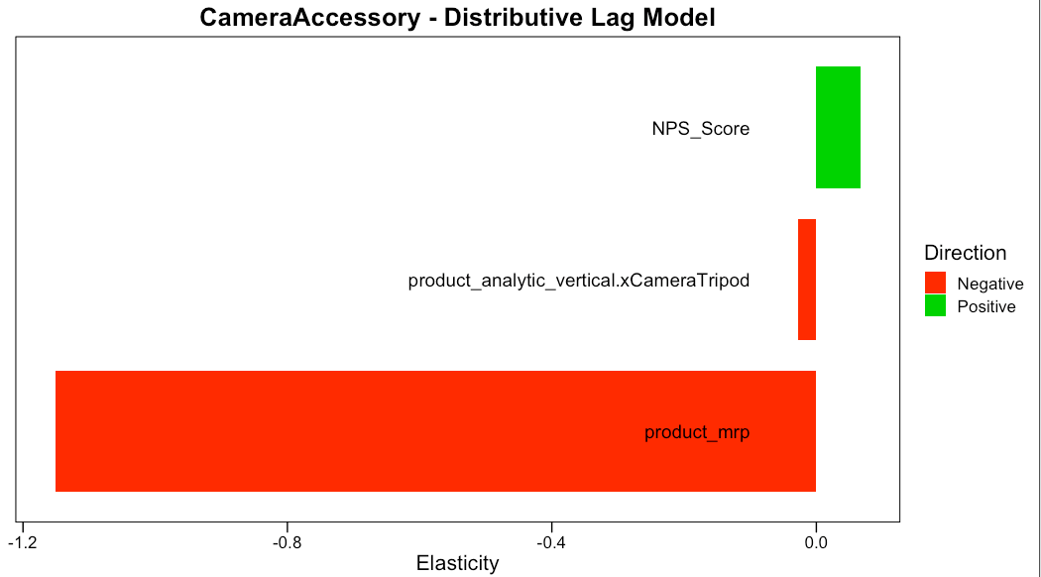
Camera Accessories
GMV depends heavily on MRP (more the MRP, lesser total sales).
Suggestion: Concentrate on smaller MRP accessories.

Slide 17
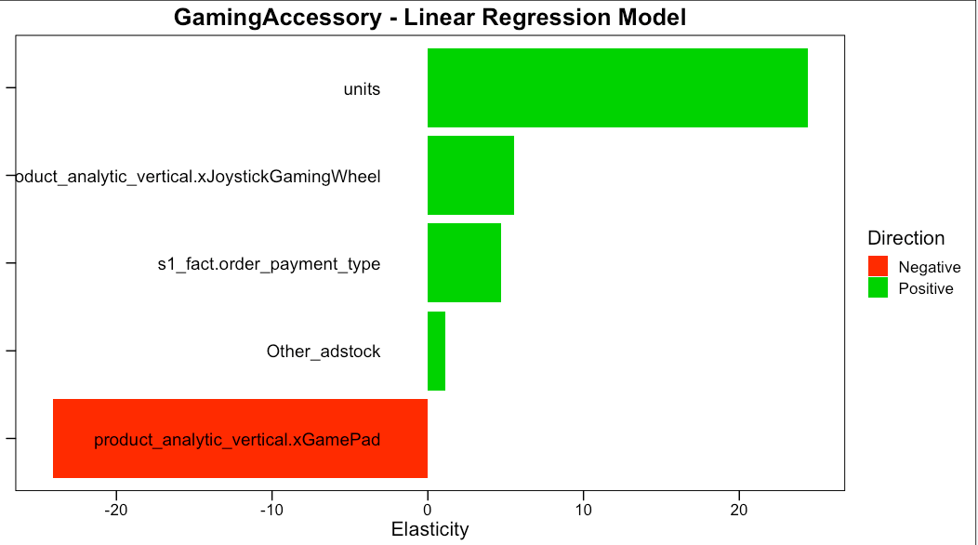
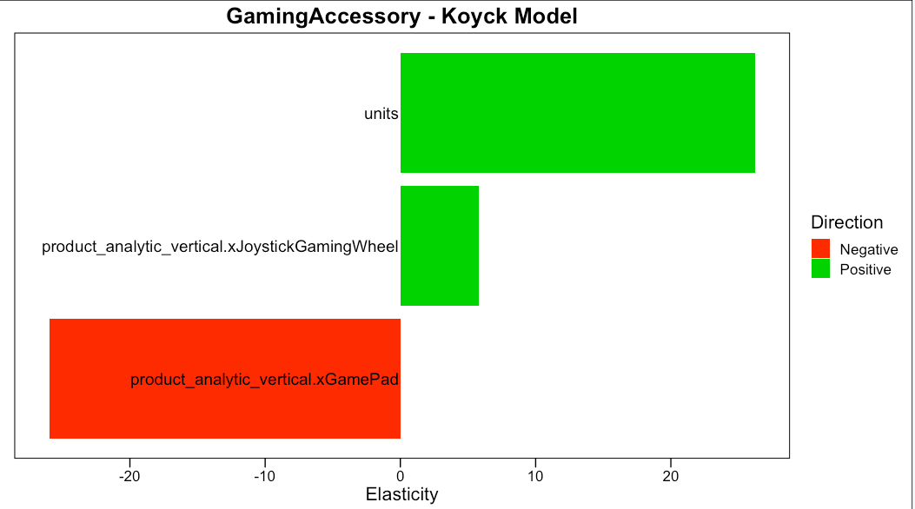
Gaming Accessories
GMV is drastically reduced by GamePad.
Gaming wheel positively affects GMV.
Suggestion: Avoid GamePads and concentrate on Gaming wheel.

Slide 18
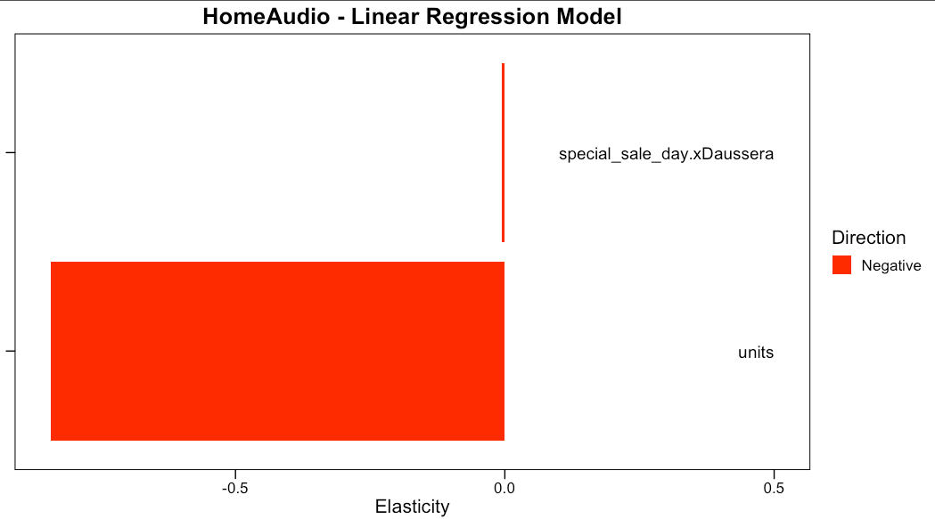
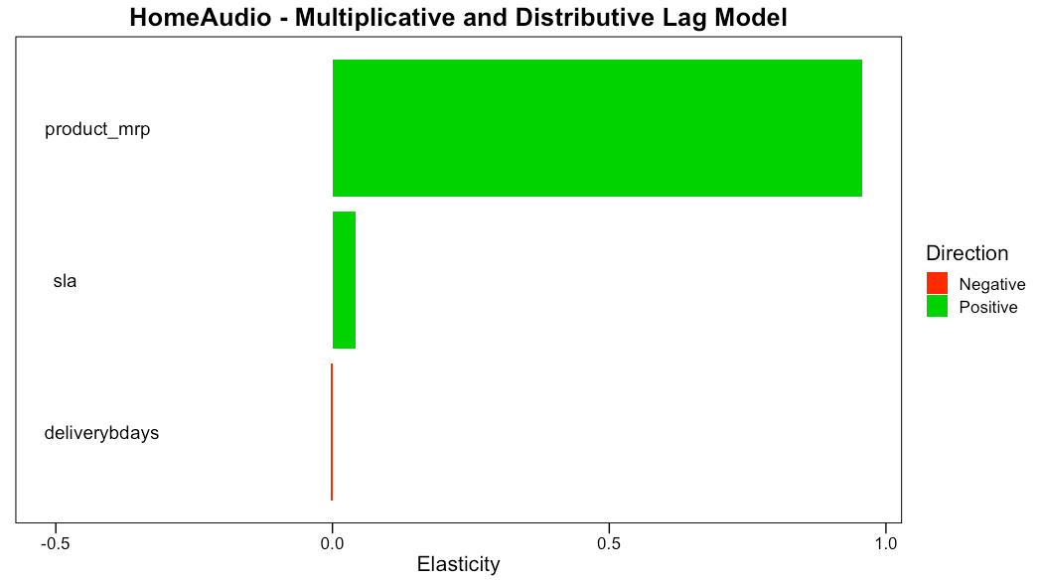
Home Audio
Number of Units negatively impact Home Audio sale.
Suggestion: Keep Pricey (premium) brands for Home Audio. Customers may not be price sensitive in case of Home Audio.

